Slide 1
Dynamic Programming
Knapsack

Slide 2
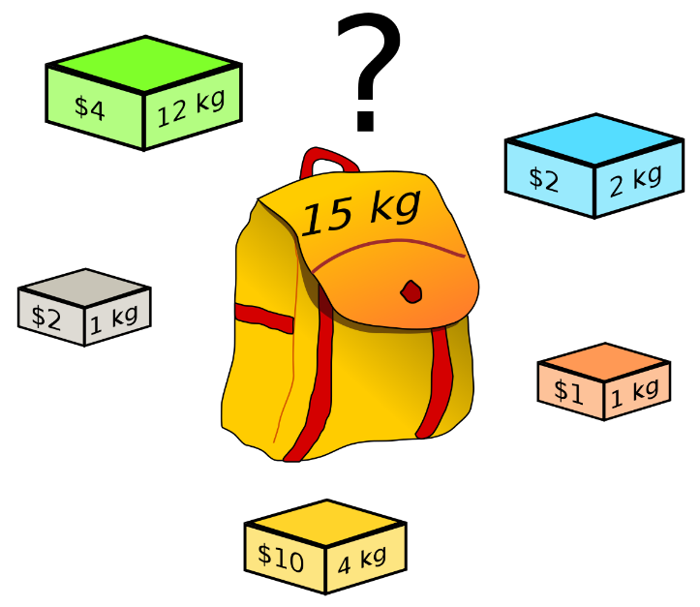
Knapsack Problem
Given n items of
integer weights: w₁ w₂ … w_{n}
values: v₁ v₂ … v_{n}
a knapsack of integer capacity W
find most valuable subset of the items that fit into the knapsack
Recursive solution?
What is smaller problem?
How to use solution to smaller
in solution to larger Table?
Order to solve?
Initial conditions?

Slide 3
Knapsack Problem (Brute Force)
Given n items of
Item x₁ x₂ … x_{n}
Since there are n items , so 2^{n} possible combinations.
We go through all possible combinations and finds the one with the most total value and with total weight less or equal W
Running time will be 2^{n}
x₁ x₂ x₃ x₄
₀ ₀ ₀ ₁
₀ ₀ ₁ ₀
₀ ₁ ₀ ₀
₁ ₀ ₀ ₀
...
…
…
₁ ₁ ₁ ₁
₂⁴₌₁₆

Slide 4
Knapsack Problem by DP (example)
Example: Knapsack of capacity W = 5
item weight value
1 2 $12
2 1 $10
3 3 $20
4 2 $15
capacity j
 | i | 0 | 1 | 2 | 3 | 4 | 5
 | 0 | 0 | 0 | 0 | 0 | 0 | 0
 | 1 | 0
 | 2 | 0
 | 3 | 0
 | 4 | 0

Slide 5
Knapsack Problem by DP (example)
Example: Knapsack of capacity W = 5
item weight value
1 2 $12
2 1 $10
3 3 $20
4 2 $15
capacity j
 | i | 0 | 1 | 2 | 3 | 4 | 5
 | 0 | 0 | 0 | 0 | 0 | 0 | 0
w₁ = 2, v₁= 12 | 1 | 0 |  | 12
 | 2 | 0
 | 3 | 0
 | 4 | 0

Slide 6
Knapsack Problem by DP (example)
Example: Knapsack of capacity W = 5
item weight value
1 2 $12
2 1 $10
3 3 $20
4 2 $15
capacity j
 | i | 0 | 1 | 2 | 3 | 4 | 5
 | 0 | 0 | 0 | 0 | 0 | 0 | 0
w₁ = 2, v₁= 12 | 1 | 0 | 0 | 12 | 12 | 12 | 12
 | 2 | 0
 | 3 | 0
 | 4 | 0
Only Item#1 is picked, having weight=2, value=12

Slide 7
Knapsack Problem by DP (example)
Example: Knapsack of capacity W = 5
item weight value
1 2 $12
2 1 $10
3 3 $20
4 2 $15
capacity j
 | i | 0 | 1 | 2 | 3 | 4 | 5
 | 0 | 0 | 0 | 0 | 0 | 0 | 0
w₁ = 2, v₁= 12 | 1 | 0 | 0 | 12 | 12 | 12 | 12
w₂ = 1, v₂= 10 | 2 | 0 | 10
 | 3 | 0
 | 4 | 0
Item#2 is picked, having weight=1, value=10

Slide 8
Knapsack Problem by DP (example)
Example: Knapsack of capacity W = 5
item weight value
1 2 $12
2 1 $10
3 3 $20
4 2 $15
capacity j
 | i | 0 | 1 | 2 | 3 | 4 | 5
 | 0 | 0 | 0 | 0 | 0 | 0 | 0
w₁ = 2, v₁= 12 | 1 | 0 | 0 | 12 | 12 | 12 | 12
w₂ = 1, v₂= 10 | 2 | 0 | 10 | 12
 | 3 | 0
 | 4 | 0
Item#1 is picked, having weight=2, value=12

Slide 9
Knapsack Problem by DP (example)
Example: Knapsack of capacity W = 5
item weight value
1 2 $12
2 1 $10
3 3 $20
4 2 $15
capacity j
 | i | 0 | 1 | 2 | 3 | 4 | 5
 | 0 | 0 | 0 | 0 | 0 | 0 | 0
w₁ = 2, v₁= 12 | 1 | 0 | 0 | 12 | 12 | 12 | 12
w₂ = 1, v₂= 10 | 2 | 0 | 10 | 12 | 22
 | 3 | 0
 | 4 | 0
Item#1 & 2 both are picked,
having weight=2+1, value=12+10

Slide 10
Knapsack Problem by DP (example)
Example: Knapsack of capacity W = 5
item weight value
1 2 $12
2 1 $10
3 3 $20
4 2 $15
capacity j
 | i | 0 | 1 | 2 | 3 | 4 | 5
 | 0 | 0 | 0 | 0 | 0 | 0 | 0
w₁ = 2, v₁= 12 | 1 | 0 | 0 | 12 | 12 | 12 | 12
w₂ = 1, v₂= 10 | 2 | 0 | 10 | 12 | 22 | 22 | 22
 | 3 | 0
 | 4 | 0
Item#1 & 2 both are picked,
having weight=2+1, value=12+10

Slide 11
Knapsack Problem by DP (example)
Example: Knapsack of capacity W = 5
item weight value
1 2 $12
2 1 $10
3 3 $20
4 2 $15
capacity j
 | i | 0 | 1 | 2 | 3 | 4 | 5
 | 0 | 0 | 0 | 0 | 0 | 0 | 0
w₁ = 2, v₁= 12 | 1 | 0 | 0 | 12 | 12 | 12 | 12
w₂ = 1, v₂= 10 | 2 | 0 | 10 | 12 | 22 | 22 | 22
w₃ = 3, v₃= 20 | 3 | 0 | 10
 | 4 | 0
Item#2 is picked, having weight=1, value=10

Slide 12
Knapsack Problem by DP (example)
Example: Knapsack of capacity W = 5
item weight value
1 2 $12
2 1 $10
3 3 $20
4 2 $15
capacity j
 | i | 0 | 1 | 2 | 3 | 4 | 5
 | 0 | 0 | 0 | 0 | 0 | 0 | 0
w₁ = 2, v₁= 12 | 1 | 0 | 0 | 12 | 12 | 12 | 12
w₂ = 1, v₂= 10 | 2 | 0 | 10 | 12 | 22 | 22 | 22
w₃ = 3, v₃= 20 | 3 | 0 | 10 | 12
 | 4 | 0
Item#1 is picked, having weight=2, value=12

Slide 13
Knapsack Problem by DP (example)
Example: Knapsack of capacity W = 5
item weight value
1 2 $12
2 1 $10
3 3 $20
4 2 $15
capacity j
 | i | 0 | 1 | 2 | 3 | 4 | 5
 | 0 | 0 | 0 | 0 | 0 | 0 | 0
w₁ = 2, v₁= 12 | 1 | 0 | 0 | 12 | 12 | 12 | 12
w₂ = 1, v₂= 10 | 2 | 0 | 10 | 12 | 22 | 22 | 22
w₃ = 3, v₃= 20 | 3 | 0 | 10 | 12 | 22
 | 4 | 0
Item#1 & 2 both
having weight=2+1, value=12+10
Item#3 only
having weight=3, value=20

Slide 14
Knapsack Problem by DP (example)
Example: Knapsack of capacity W = 5
item weight value
1 2 $12
2 1 $10
3 3 $20
4 2 $15
capacity j
 | i | 0 | 1 | 2 | 3 | 4 | 5
 | 0 | 0 | 0 | 0 | 0 | 0 | 0
w₁ = 2, v₁= 12 | 1 | 0 | 0 | 12 | 12 | 12 | 12
w₂ = 1, v₂= 10 | 2 | 0 | 10 | 12 | 22 | 22 | 22
w₃ = 3, v₃= 20 | 3 | 0 | 10 | 12 | 22 | 30
 | 4 | 0
Item#2 & 3 both.
having weight=3+1, value=10+20

Slide 15
Knapsack Problem by DP (example)
Example: Knapsack of capacity W = 5
item weight value
1 2 $12
2 1 $10
3 3 $20
4 2 $15
capacity j
 | i | 0 | 1 | 2 | 3 | 4 | 5
 | 0 | 0 | 0 | 0 | 0 | 0 | 0
w₁ = 2, v₁= 12 | 1 | 0 | 0 | 12 | 12 | 12 | 12
w₂ = 1, v₂= 10 | 2 | 0 | 10 | 12 | 22 | 22 | 22
w₃ = 3, v₃= 20 | 3 | 0 | 10 | 12 | 22 | 30 | 32
 | 4 | 0
Item#1 & 3 both.
having weight=2+3, value=12+20

Slide 16
Knapsack Problem by DP (example)
Example: Knapsack of capacity W = 5
item weight value
1 2 $12
2 1 $10
3 3 $20
4 2 $15
capacity j
 | i | 0 | 1 | 2 | 3 | 4 | 5
 | 0 | 0 | 0 | 0 | 0 | 0 | 0
w₁ = 2, v₁= 12 | 1 | 0 | 0 | 12 | 12 | 12 | 12
w₂ = 1, v₂= 10 | 2 | 0 | 10 | 12 | 22 | 22 | 22
w₃ = 3, v₃= 20 | 3 | 0 | 10 | 12 | 22 | 30 | 32
 | 4 | 0
Item#1 & 3 both.
having weight=2+3, value=12+20

Slide 17
Knapsack Problem by DP (example)
Example: Knapsack of capacity W = 5
item weight value
1 2 $12
2 1 $10
3 3 $20
4 2 $15
capacity j
 | i | 0 | 1 | 2 | 3 | 4 | 5
 | 0 | 0 | 0 | 0 | 0 | 0 | 0
w₁ = 2, v₁= 12 | 1 | 0 | 0 | 12 | 12 | 12 | 12
w₂ = 1, v₂= 10 | 2 | 0 | 10 | 12 | 22 | 22 | 22
w₃ = 3, v₃= 20 | 3 | 0 | 10 | 12 | 22 | 30 | 32
w₄ = 2, v₄= 15 | 4 | 0 | 10
Item#2 is picked, having weight=1, value=10

Slide 18
Knapsack Problem by DP (example)
Example: Knapsack of capacity W = 5
item weight value
1 2 $12
2 1 $10
3 3 $20
4 2 $15
capacity j
 | i | 0 | 1 | 2 | 3 | 4 | 5
 | 0 | 0 | 0 | 0 | 0 | 0 | 0
w₁ = 2, v₁= 12 | 1 | 0 | 0 | 12 | 12 | 12 | 12
w₂ = 1, v₂= 10 | 2 | 0 | 10 | 12 | 22 | 22 | 22
w₃ = 3, v₃= 20 | 3 | 0 | 10 | 12 | 22 | 30 | 32
w₄ = 2, v₄= 15 | 4 | 0 | 10 | 15
Item#1
having weight=2,
value=12
Item#4
having weight=2,
value=15

Slide 19
Knapsack Problem by DP (example)
Example: Knapsack of capacity W = 5
item weight value
1 2 $12
2 1 $10
3 3 $20
4 2 $15
capacity j
 | i | 0 | 1 | 2 | 3 | 4 | 5
 | 0 | 0 | 0 | 0 | 0 | 0 | 0
w₁ = 2, v₁= 12 | 1 | 0 | 0 | 12 | 12 | 12 | 12
w₂ = 1, v₂= 10 | 2 | 0 | 10 | 12 | 22 | 22 | 22
w₃ = 3, v₃= 20 | 3 | 0 | 10 | 12 | 22 | 30 | 32
w₄ = 2, v₄= 15 | 4 | 0 | 10 | 15 | 25
Item#1 & 2
weight=2+1,
value=12+10
Item#3
weight=3,
value=20
Item# 2 & 4
weight=1+2,
value=10+15

Slide 20
Knapsack Problem by DP (example)
Example: Knapsack of capacity W = 5
item weight value
1 2 $12
2 1 $10
3 3 $20
4 2 $15
capacity j
 | i | 0 | 1 | 2 | 3 | 4 | 5
 | 0 | 0 | 0 | 0 | 0 | 0 | 0
w₁ = 2, v₁= 12 | 1 | 0 | 0 | 12 | 12 | 12 | 12
w₂ = 1, v₂= 10 | 2 | 0 | 10 | 12 | 22 | 22 | 22
w₃ = 3, v₃= 20 | 3 | 0 | 10 | 12 | 22 | 30 | 32
w₄ = 2, v₄= 15 | 4 | 0 | 10 | 15 | 25 | 30
Item#1 & 4
weight=2+2,
value=12+15
Item# 2 & 3
weight=1+3,
value=10+20

Slide 21
Knapsack Problem by DP (example)
Example: Knapsack of capacity W = 5
item weight value
1 2 $12
2 1 $10
3 3 $20
4 2 $15
capacity j
 | i | 0 | 1 | 2 | 3 | 4 | 5
 | 0 | 0 | 0 | 0 | 0 | 0 | 0
w₁ = 2, v₁= 12 | 1 | 0 | 0 | 12 | 12 | 12 | 12
w₂ = 1, v₂= 10 | 2 | 0 | 10 | 12 | 22 | 22 | 22
w₃ = 3, v₃= 20 | 3 | 0 | 10 | 12 | 22 | 30 | 32
w₄ = 2, v₄= 15 | 4 | 0 | 10 | 15 | 25 | 30 | 37
Item#1 & 3
weight=2+3,
value=12+20
Item#3 & 4
weight=3+2,
value=20+15
Item# 1 , 2 & 4
weight=2+1+2,
value=12+10+15

Slide 22
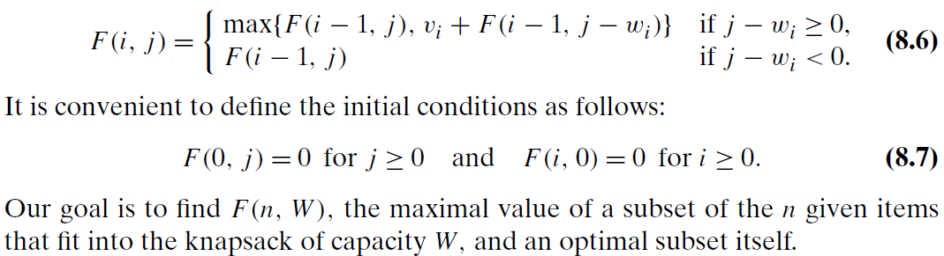
Knapsack Problem
Recursive Definition
Among the subsets that do not include the ith item, the value of an optimal
subset is, by definition, F(i − 1, j)

Slide 23
Knapsack Problem
Recursive Definition
do include the ith item (hence, j − wi≥ 0), an optimal
subset is made up of this item and an optimal subset of the first i − 1 items
that fits into the knapsack of capacity j − wi . The value of such an optimal
subset is vi + F(i − 1, j − wi).

Slide 24

Knapsack Problem by DP (example)
Example: Knapsack of capacity W = 5
item weight value
1 2 $12
2 1 $10
3 3 $20
4 2 $15
capacity j
 | i | 0 | 1 | 2 | 3 | 4 | 5
 | 0 | 0 | 0 | 0 | 0 | 0 | 0
w₁ = 2, v₁= 12 | 1 | 0 | 0 | 12 | 12 | 12 | 12
w₂ = 1, v₂= 10 | 2 | 0 | 10 | 12 | 22 | 22 | 22
w₃ = 3, v₃= 20 | 3 | 0 | 10 | 12 | 22 | 30 | 32
w₄ = 2, v₄= 15 | 4 | 0 | 10
i=4 j=1
j − w_{i} =1-2=-1 <0
F(3, 1)

Slide 25
Knapsack Problem by DP (example)
Example: Knapsack of capacity W = 5
item weight value
1 2 $12
2 1 $10
3 3 $20
4 2 $15
capacity j
 | i | 0 | 1 | 2 | 3 | 4 | 5
 | 0 | 0 | 0 | 0 | 0 | 0 | 0
w₁ = 2, v₁= 12 | 1 | 0 | 0 | 12 | 12 | 12 | 12
w₂ = 1, v₂= 10 | 2 | 0 | 10 | 12 | 22 | 22 | 22
w₃ = 3, v₃= 20 | 3 | 0 | 10 | 12 | 22 | 30 | 32
w₄ = 2, v₄= 15 | 4 | 0 | 10 | 15
i=4, j=2
j − w_{i} =2-2=0 >=0
Max { F(3, 2), 15 + F( 3, 0) }

Slide 26
Knapsack Problem by DP (example)
Example: Knapsack of capacity W = 5
item weight value
1 2 $12
2 1 $10
3 3 $20
4 2 $15
capacity j
 | i | 0 | 1 | 2 | 3 | 4 | 5
 | 0 | 0 | 0 | 0 | 0 | 0 | 0
w₁ = 2, v₁= 12 | 1 | 0 | 0 | 12 | 12 | 12 | 12
w₂ = 1, v₂= 10 | 2 | 0 | 10 | 12 | 22 | 22 | 22
w₃ = 3, v₃= 20 | 3 | 0 | 10 | 12 | 22 | 30 | 32
w₄ = 2, v₄= 15 | 4 | 0 | 10 | 15 | 25
i=4, j=3
j − w_{i} =3-2=1 >=0
Max { F(3, 3), 15 + F( 3, 1) }
Max { 22, 15+10 }

Slide 27
Knapsack Problem by DP (example)
Example: Knapsack of capacity W = 5
item weight value
1 2 $12
2 1 $10
3 3 $20
4 2 $15
capacity j
 | i | 0 | 1 | 2 | 3 | 4 | 5
 | 0 | 0 | 0 | 0 | 0 | 0 | 0
w₁ = 2, v₁= 12 | 1 | 0 | 0 | 12 | 12 | 12 | 12
w₂ = 1, v₂= 10 | 2 | 0 | 10 | 12 | 22 | 22 | 22
w₃ = 3, v₃= 20 | 3 | 0 | 10 | 12 | 22 | 30 | 32
w₄ = 2, v₄= 15 | 4 | 0 | 10 | 15 | 25 | 30
i=4, j=4
j − w_{i} =4-2=2 >=0
Max { F(3, 4), 15 + F( 3, 2) }
Max { 30, 15+12 }

Slide 28
Knapsack Problem by DP (example)
Example: Knapsack of capacity W = 5
item weight value
1 2 $12
2 1 $10
3 3 $20
4 2 $15
capacity j
 | i | 0 | 1 | 2 | 3 | 4 | 5
 | 0 | 0 | 0 | 0 | 0 | 0 | 0
w₁ = 2, v₁= 12 | 1 | 0 | 0 | 12 | 12 | 12 | 12
w₂ = 1, v₂= 10 | 2 | 0 | 10 | 12 | 22 | 22 | 22
w₃ = 3, v₃= 20 | 3 | 0 | 10 | 12 | 22 | 30 | 32
w₄ = 2, v₄= 15 | 4 | 0 | 10 | 15 | 25 | 30 | 37
i=4, j=5
j − w_{i} =5-2=3 >=0
Max { F(3, 5), 15 + F( 3, 3) }
Max { 32, 15+22 }

Slide 29
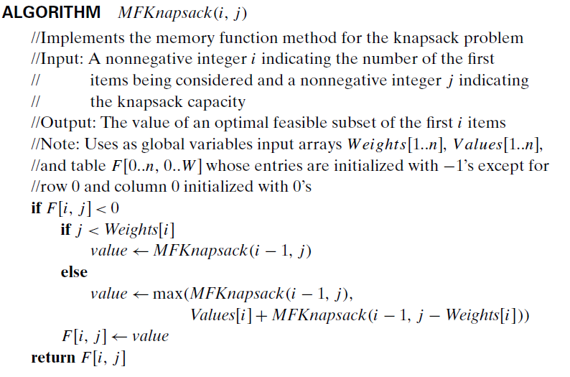
Knapsack Problem
Recursive Algorithm

Slide 30
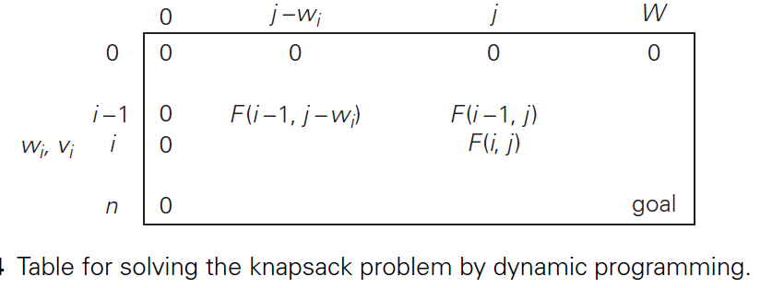
Knapsack Problem

Slide 31
Knapsack Problem by DP (example)
Example: Knapsack of capacity W = 5
item weight value
1 2 $12
2 1 $10
3 3 $20
4 2 $15
capacity j
 | i | 0 | 1 | 2 | 3 | 4 | 5
 | 0 | 0 | 0 | 0 | 0 | 0 | 0
w₁ = 2, v₁= 12 | 1 | 0 | 0 | 12 | 12 | 12 | 12
w₂ = 1, v₂= 10 | 2 | 0 | - | 12 | 22 | - | 22
w₃ = 3, v₃= 20 | 3 | 0 | - | - | 22 | - | 32
w₄ = 2, v₄= 15 | 4 | 0 | - | - | - | - | 37

Slide 32
Knapsack Problem by DP (example)
capacity j
 | i | 0 | 1 | 2 | 3 | 4 | 5
 | 0 | 0 | 0 | 0 | 0 | 0 | 0
w₁ = 2, v₁= 12 | 1 | 0 | 0 | 12 | 12 | 12 | 12
w₂ = 1, v₂= 10 | 2 | 0 | - | 12 | 22 | - | 22
w₃ = 3, v₃= 20 | 3 | 0 | - | - | 22 | - | 32
w₄ = 2, v₄= 15 | 4 | 0 | - | - | - | - | 37
We can find the composition of an optimal subset by backtracking the computations of this entry in the table.
Since F(4, 5) > F(3, 5), item 4 has to be included in an optimal solution along with an optimal subset for filling 5 − 2 = 3 remaining units of the knapsack capacity.
The value of the latter is F(3, 3).
Since F(3, 3) = F(2, 3), item 3 need not be in an optimal subset.
Since F(2, 3) > F(1, 3), item 2 is a part of an optimal selection,
which leaves element F(1, 3 − 1) to specify its remaining composition.
Similarly,
since F(1, 2) > F(0, 2), item 1 is the final part of the optimal solution
{item 1, item 2, item 4}

Slide 33
Knapsack Problem
The time efficiency and space efficiency of this algorithm are both in Ѳ(nW).
The time needed to find the composition of an optimal solution is in O(n).

Slide 34

Knapsack Problem
Chapter #8 (Dynamic Programming)
Knapsack Problem (8.2)
Page # 292 – 297
Introduction to the Design and Analysis of Algorithms 3rd Edition,
by Anany Levitin

